Slide 1

Just Enough Docker To Break into DevOps
By
Eng. Ahmad Almla Rashed & Eng. Ali Johmani
All lesson materials, and exercises are available in the course repository:
https://github.com/ByteFortified/dockerworkshop

Slide 2

Docker in a Nutshell
What Problem Does It Solve?

Slide 3
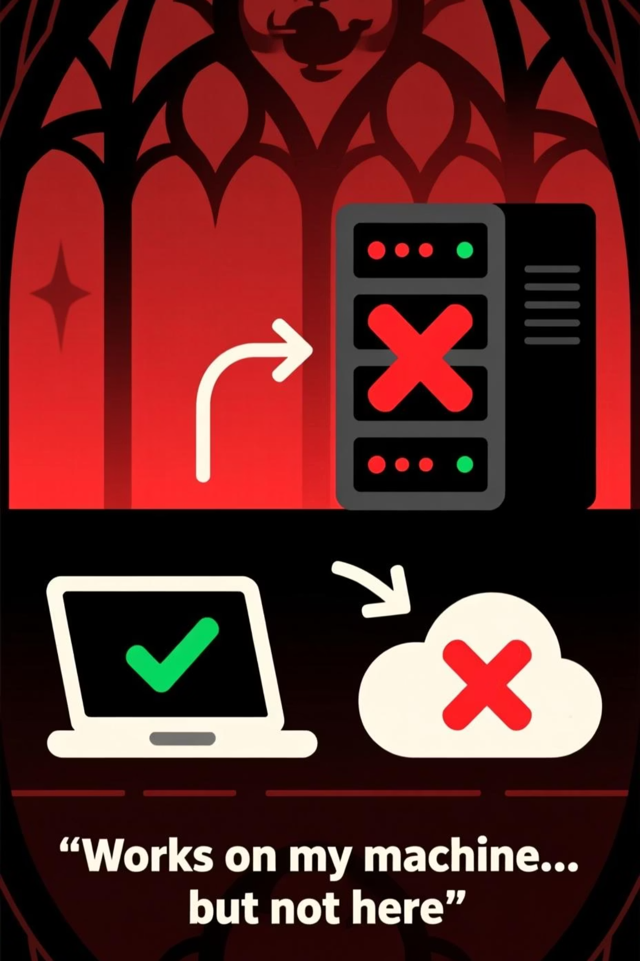
Why do we need Docker?
Applications often break when moved between different environments, like from your development machine to a testing server, or from testing to production. This leads to the infamous "It works on my machine!" problem.
Works on my machine… but not here

Slide 4
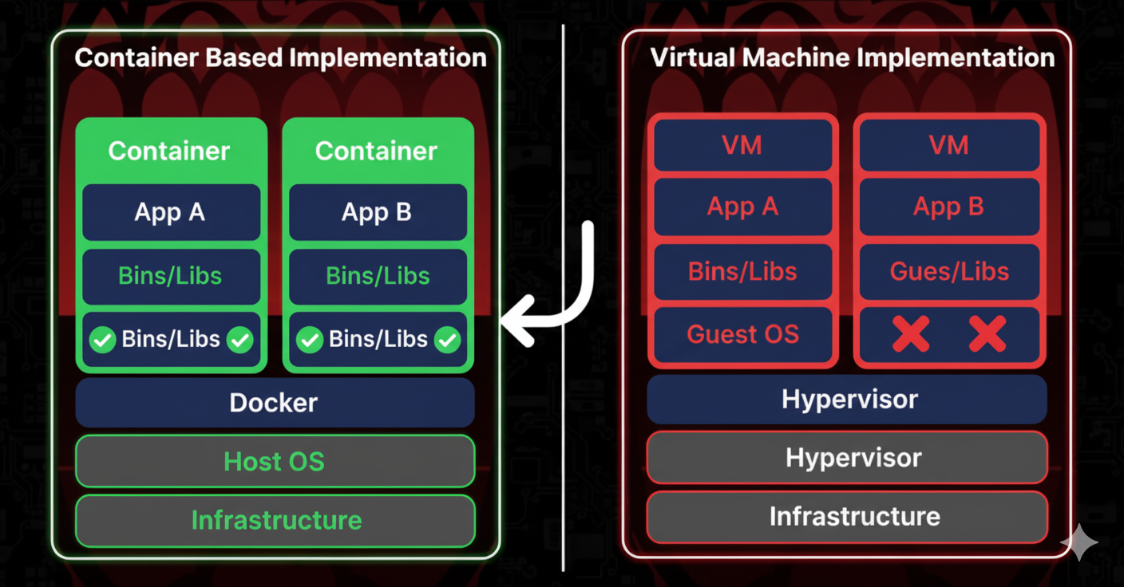

containerization vs virtualization

Slide 5
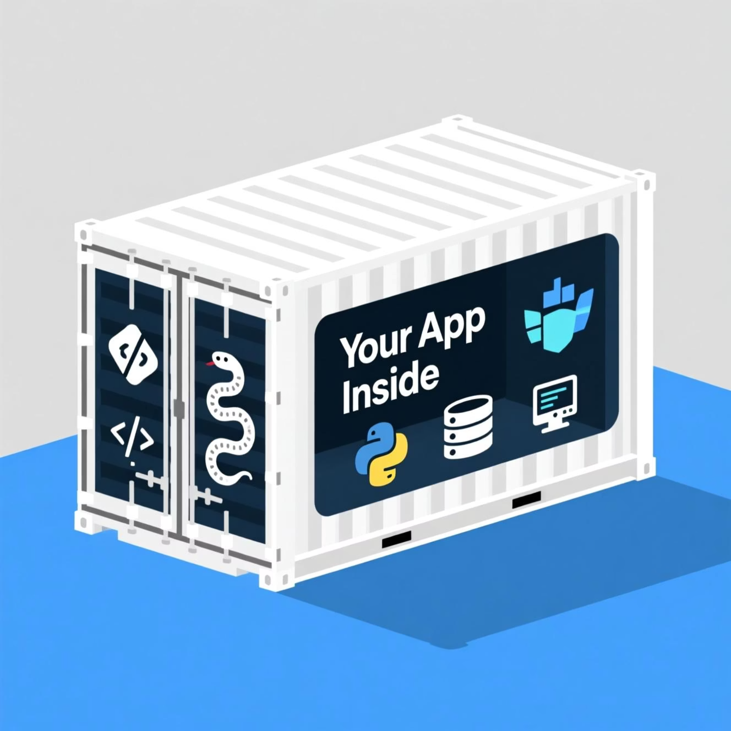
What is Docker in simple terms?
Docker packages your application and all its necessary components – code, runtime, libraries, environment variables – into a single, lightweight, and portable unit called a container. Think of it like a standardized shipping container for your code.
Ship code anywhere

Slide 6
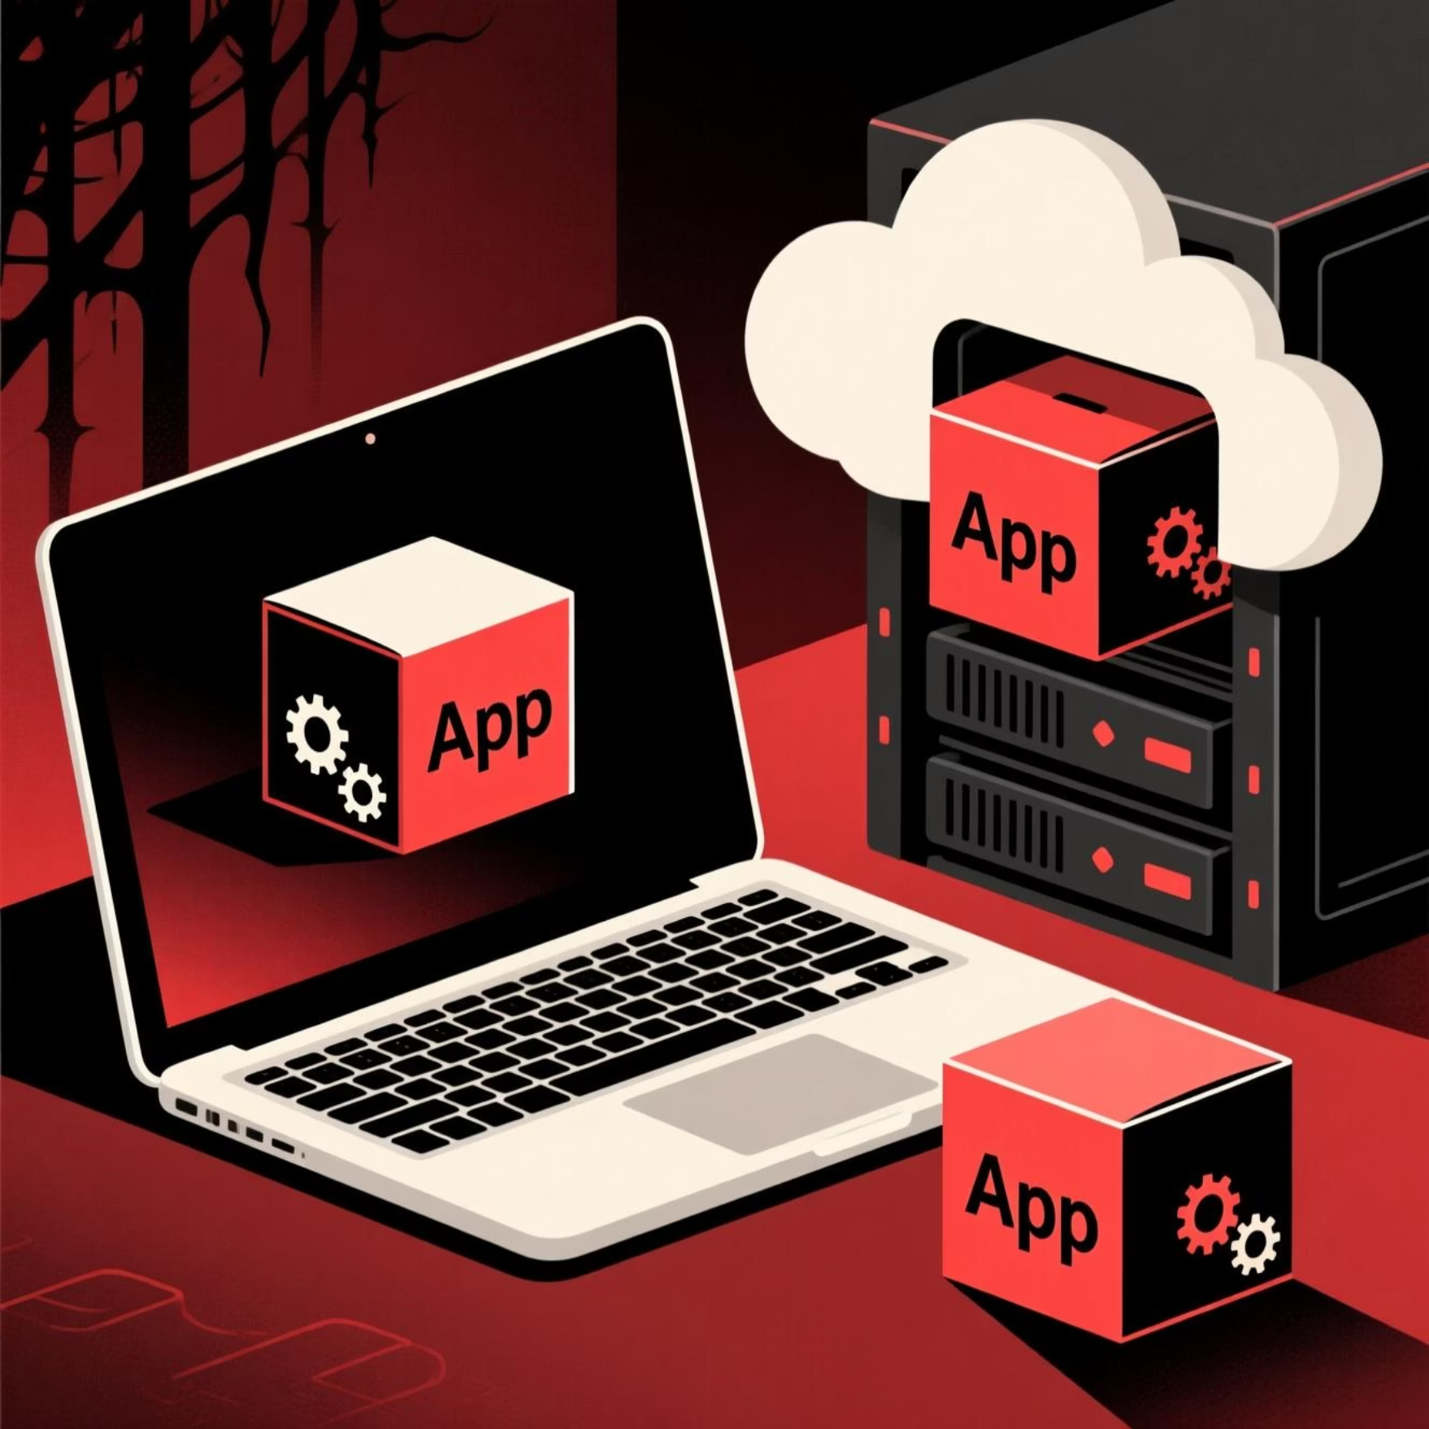

Containers & Images
The Building Blocks of Docker
The Container: A Running Instance
The Image: The Blueprint
Think of a container as the actual, living, breathing instance of your application running in isolation. It's a lightweight, executable package that includes everything needed to run a piece of software, including the code, a runtime, system tools, system libraries and settings.
Before you can have a running container, you need an image. An image is a read-only template that contains all the instructions and components needed to create a container. It's like the detailed blueprint or recipe for your application's environment.
Your app, consistently running everywhere.
Image = Blueprint, Container = House

Slide 7
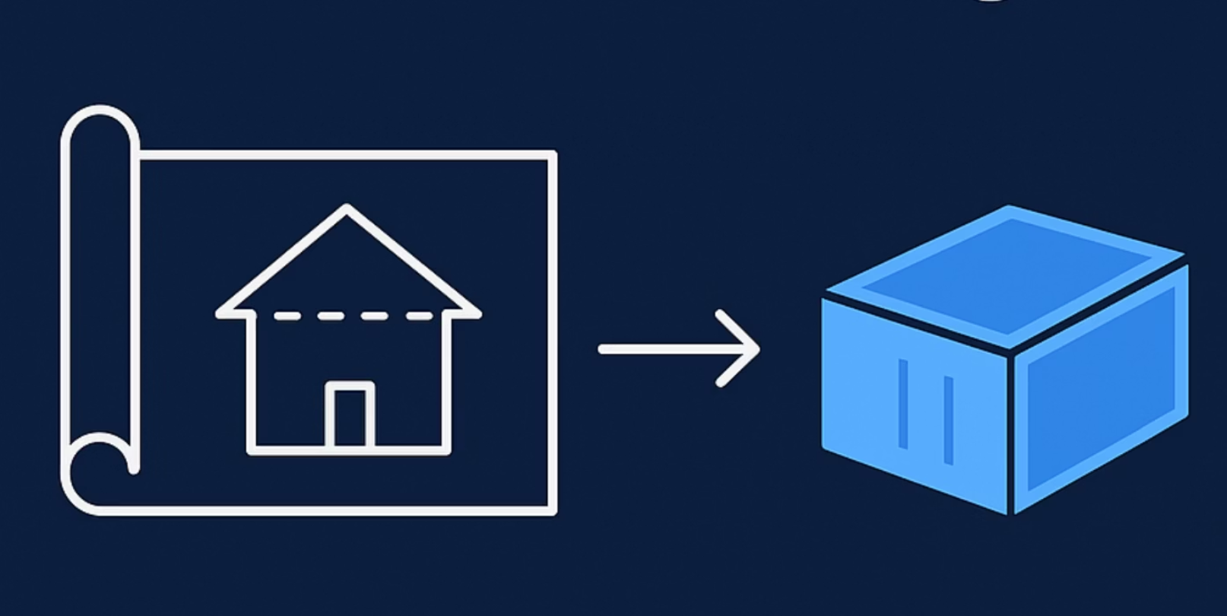
What is an image?
An image is a read-only template that contains your application and its dependencies, essentially a blueprint for creating containers. It tells Docker exactly what to run.
Images are instructions,
Containers are execution.

Slide 8
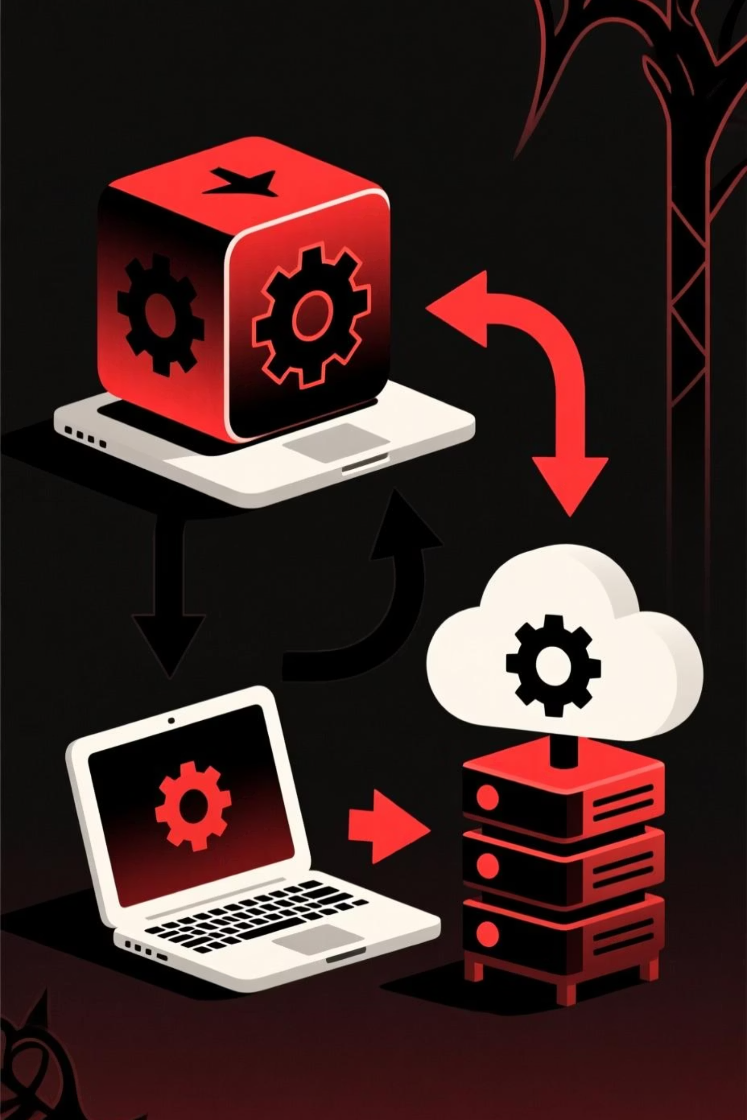
What is a container?
A container is a running, isolated instance of your application, bundled with everything it needs to run consistently. It ensures that your application behaves the same way, regardless of where it's deployed.
Same box, everywhere

Slide 9

Running Containers with docker run
What It Does
- The docker run command creates and starts a new container from a Docker image.
- It combines the creation (docker create) and start (docker start) steps in one command.
Example: docker run -d -p 8080:80 --name webapp nginx
Options | Description
-d | Run container in detached mode (background)
-it | Run interactively with a terminal (for CLI tools)
-p <host:container> | Map host port to container port
-v <host:container> | Mount a volume or host directory
--env or -e | Set environment variables
--name | Assign a custom name to the container
--rm | Automatically remove container after it exits

Slide 10
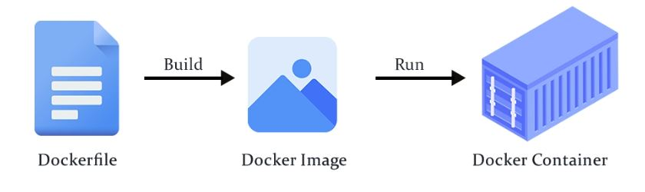
Building Images with docker build
What It Does:
- The docker build command reads instructions from a Dockerfile and creates a Docker image.
- Each line in the Dockerfile (e.g., RUN, COPY, ENV) becomes a layer in the image.
- When the build finishes, you get a reusable image that can be shared or run anywhere
Basic Syntax: docker build -t myapp:latest .
Option:
-t <name>
-f <file>
--no-cache
--build-arg <key=value>

Slide 11


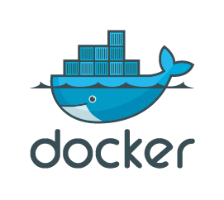

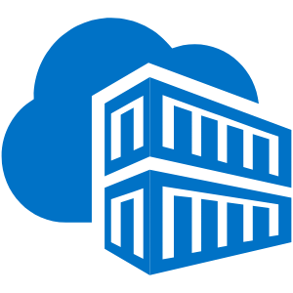
Dockerfile
How does Docker know what to build and where to share it?
Dockerfile
Registry (e.g., Docker Hub)
This is a simple text file that contains a series of commands (like a recipe!) Docker uses to build an image. It specifies everything from the base operating system to copying application code and installing dependencies. It's your ultimate build script!
Once you've built your perfect Docker image, where do you put it? A registry is a centralized repository for Docker images. Think of it like GitHub for your code, but for your Docker images. Docker Hub is the most popular public registry, allowing you to store, share, and pull images globally.
# Example Dockerfile snippet
FROM node:18
WORKDIR /app
COPY package*.json ./
RUN npm install
COPY . .
CMD ["npm", "start"]
Docker Hub
Google Container
Registry
Azure Container
Registry

Slide 12
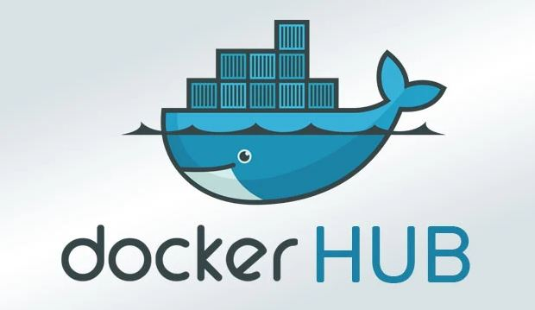
Docker Hub and Customize image
Docker Hub:
simplifies development with a powerful container registry for storing, managing, and sharing Docker images.
Public Repository
Anyone can see and pull the image without logging in.
Private Repository
Only authenticated users with permission can see and pull the image.
Create customize image from docker container
docker commit container_id imagename

Slide 13
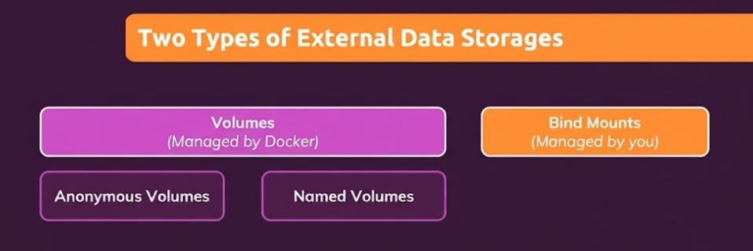
Docker Storage
Containers are ephemeral — their data disappears when removed.
Volumes solve this by providing persistent, Docker-managed storage.
Allow data sharing between containers and safe persistence after restarts.

Slide 14
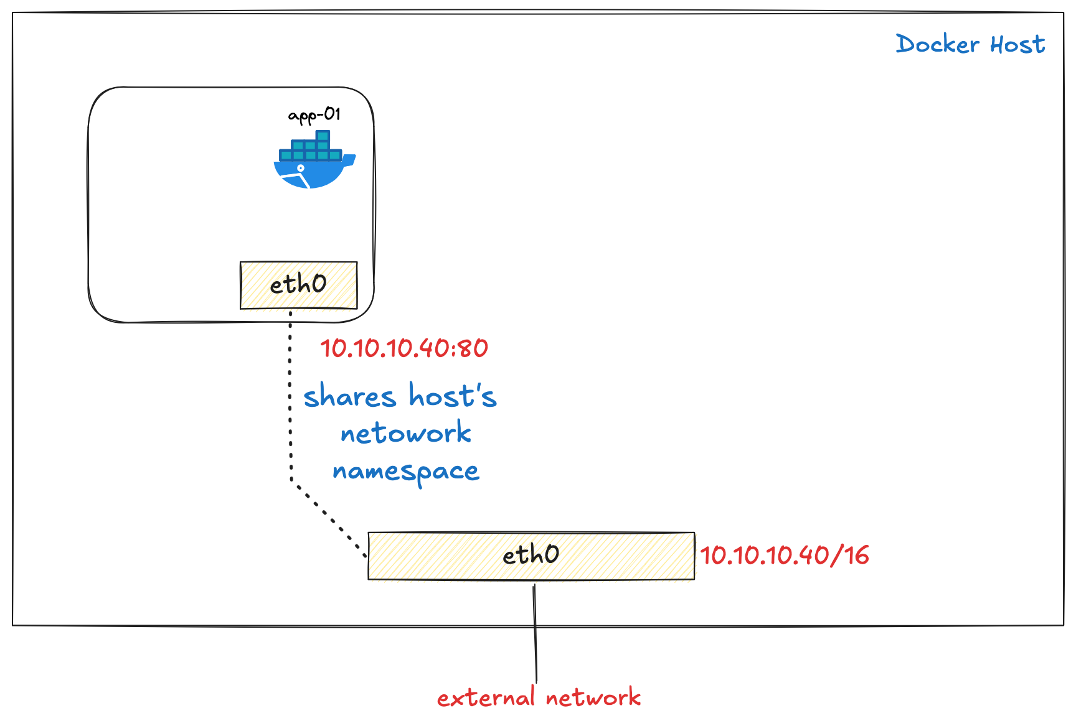
Docker Networks
Host Network: . shares host network stack
. Uses host IP directly
. Fast, no NAT; lower latency
. No isolation; possible port conflicts

Slide 15
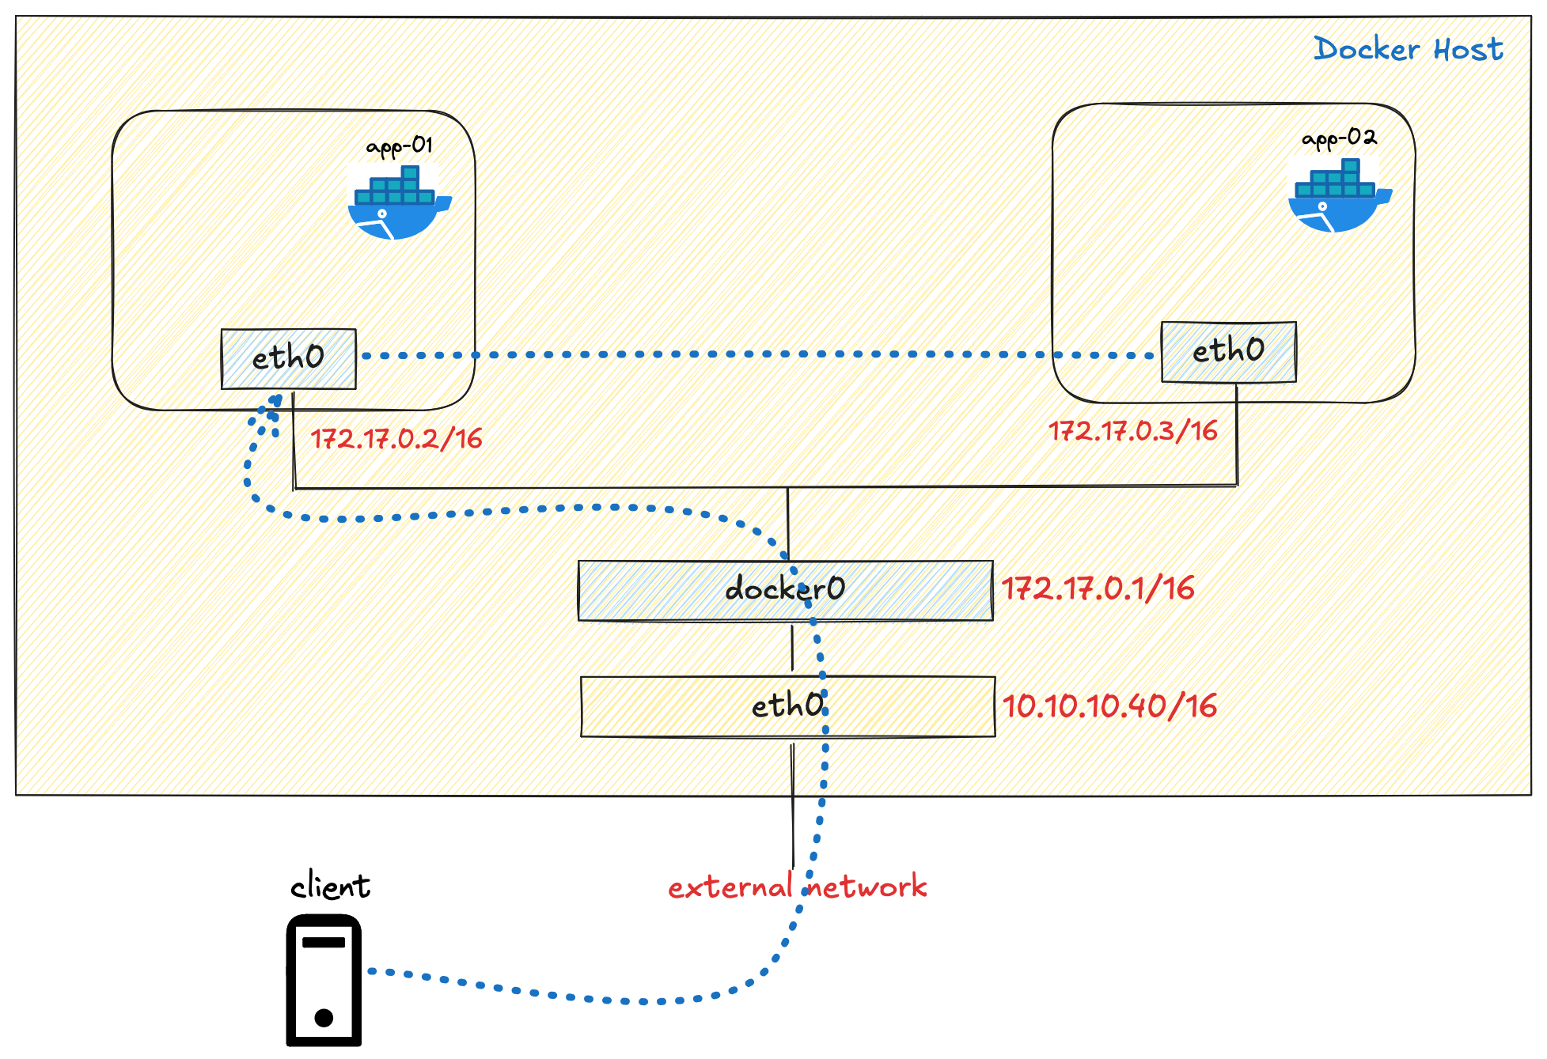
Docker Networks
Bridge Network: . Each container gets its own virtual ethernet interface . High — containers isolated from host
. Requires `-p` to expose ports

Slide 16
Docker Container Maintenance & Troubleshooting
Once your container is running, we need tools to:
- Monitor its health and activity
- Diagnose errors and performance issues
- Inspect configuration and metadata
Command | Description
docker ps | List running containers
docker logs <container> | View container output (stdout/stderr)
docker exec -it <container> sh | Access the container shell
docker inspect <container> | Show detailed configuration and metadata
docker stats | Display real-time CPU, memory, and network usage
docker top <container> | Show running processes inside container
docker restart <container> | Restart a container
docker rm <container> | Remove stopped containers

Slide 17

migrate docker containers between hosts
A- using docker registry like Docker Hub
B- using manual process example: 1. Create customize image from the docker container docker commit my_container my_container_image
2. Save the Image to archive file docker save -o ~/my_container_image.tar my_container_image
3. Transfer the archive file to the New Server
scp ~/my_container_image.tar ubuntu@192.168.1.2:/home/ubuntu/
4. On the Destination Server
Load the Image from the archive file
docker load -i /home/ubuntu/my_container_image.tar

Slide 18
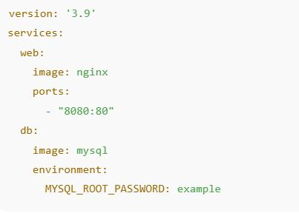
Docker Compose — Managing Multi-Container Applications
- Docker Compose simplifies the process of defining, running, and managing multi-container applications using a single YAML configuration file.
- Instead of typing long docker run commands, you describe your services once and start them all together.
Compose uses a docker-compose.yml file to define:
📦 Services (containers)
🗂️ Volumes
🌐 Networks
⚙️ Environment variables & build context
Command | Description
docker-compose up -d | Build and start containers in background
docker-compose down | Stop and remove containers, networks, volumes
docker-compose logs | View logs for all services
docker-compose ps | List running services
docker-compose build | Rebuild services based on Dockerfiles

Slide 19
Demo Time: Docker in Action
With one click, Docker Compose spins up your entire app stack – web app, database, cache, and more – all running in containers, all consistent across environments.
“One click. Full stack. Anywhere.”

Slide 20

Q & A

Slide 21
Connect with us
Ahmad Almla Rashed
https://www.linkedin.com/in/ahmad-almla-rashed/
Ali Aljohmani
https://www.linkedin.com/in/ali-aljohmani-921366176/

